Slide 1
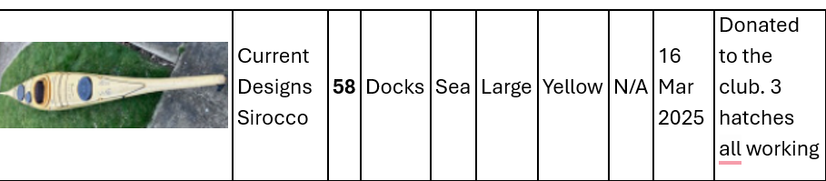
Stewardship group meeting 8pm
Monday, 24 March⋅20:00 – 21:30
At the Marina.
The agenda will be finalised by Adya / Roy but if you have any items please send details to: chair@liverpoolcanoeclub.co.uk / secretary@liverpoolcanoeclub.co.uk
1/ Equipment update New Sea kayak donated – Fixed by KS
Nova Craft Prospector open to be sold to the club from KS – Worth £850 but will sell for £450 (as agreed with Pete Thomas). Waiting until after DW event – space on the racks.
Propose to purchase 4-5 plastic SUPs from Water Sports Centre KS
Do we need new boats? eg sea kayaks?
10 Larger / XL BA for the polo team - CC

Slide 2
2/ New pool sessions are going well. Price increase in April 10%. Should we offer a junior session in the small pool over the summer??
3/ LCC Club Paddlefest – for club members and their guests only.
Bookable 1 hr sessions : Sea Kayak intro / Open Canoe intro / SUP intro / Polo taster / Try any boat session in front of the compound / Rolling competition / Coburg dock fun race / Come and buy it sale for anything canoe related.
We need named people to lead these sessions and also 6 safety kayakers.

Slide 3
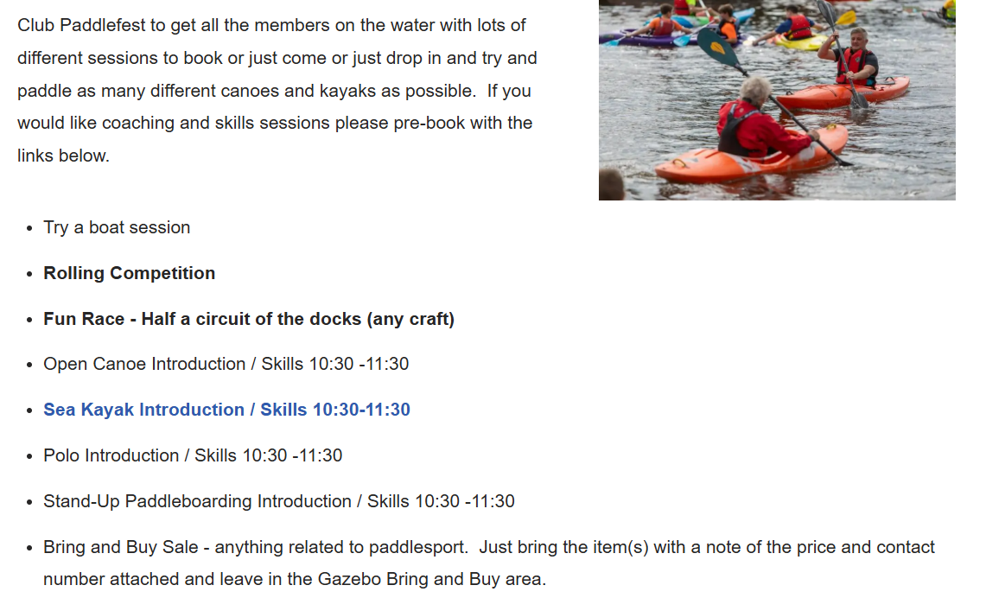

Slide 4
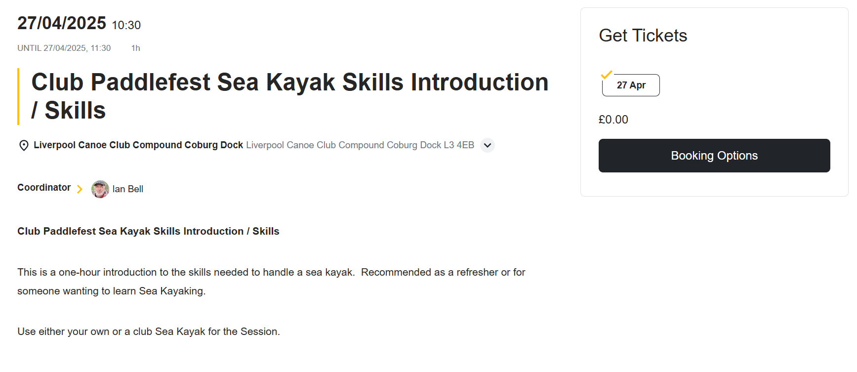

Slide 5
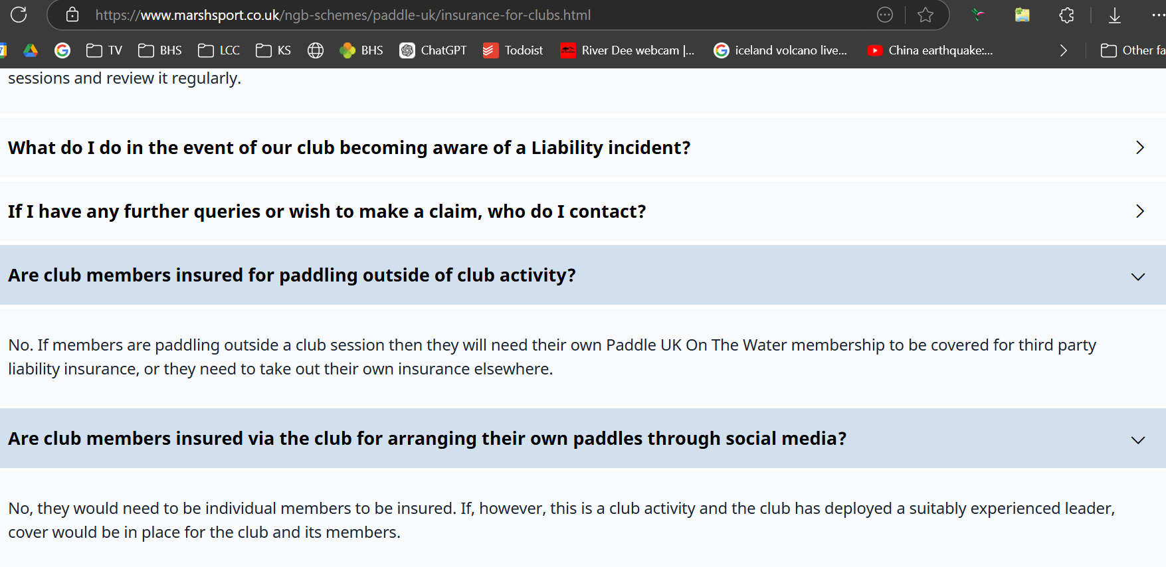
4/ Use of the Marina for club talks/meetings/socials after paddles
5/ New calendar and events: evaluation. Should peer paddles appear on the calendar?? Insurance for clubs

Slide 6
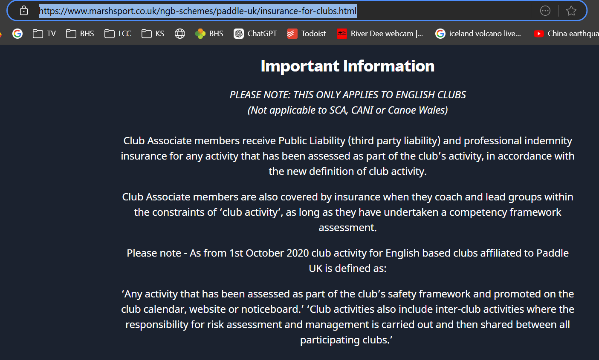




Slide 7
6/ Club messaging system going forward. What is the plan?

Slide 8
7/ Club Development Plan 2-3 year plan needed rather than last minute agenda points. Club Log?
8/ Club maintenance day? – Need to be organised to update the kit.
9/ PUK standards for deployment update? Where do we stand?

Slide 9
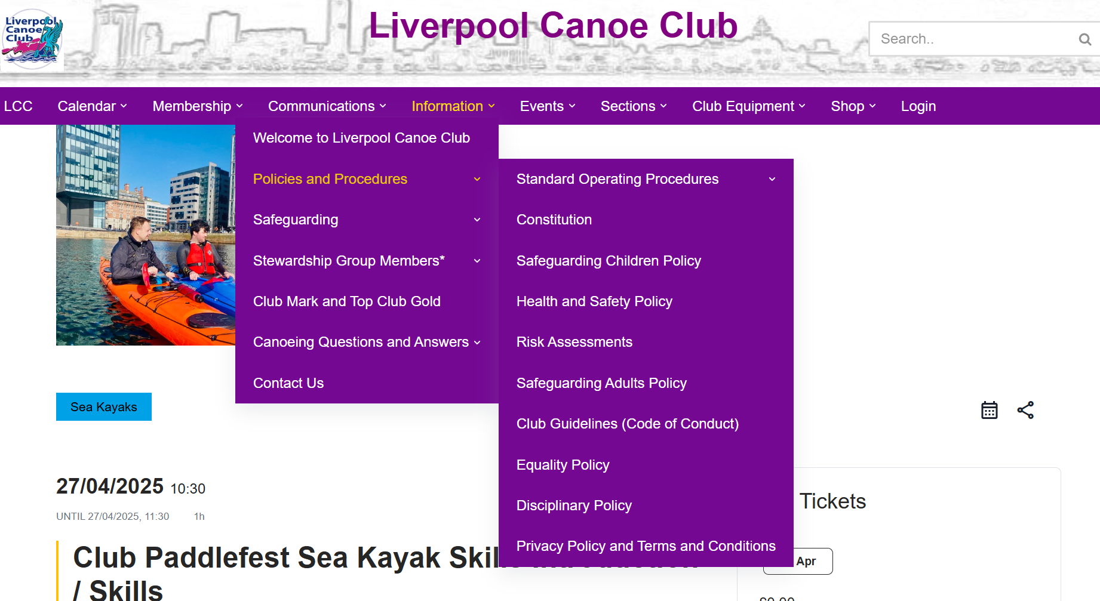

Slide 10
